Slide 1
APOLOGETICS
IN ONE LESSON
almost
Ai1L.net
Lesson 7
The Primacy of the Primary Sources

Slide 2


Slide 3
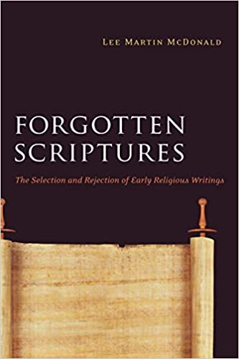

Slide 4
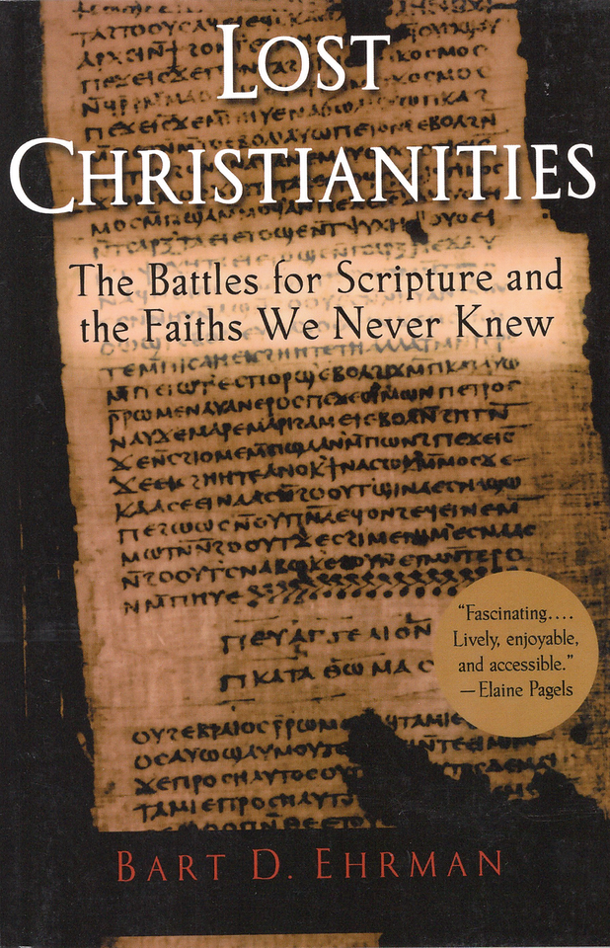

Slide 5
Write down some observations regarding the following verses regarding Jesus’ authority
1

Slide 6
Write down some observations regarding the following verses regarding the Apostles’ authority
2

Slide 7
Write down some observations regarding the authority of the Apostles’ writing
3

Slide 8
Jesus
Apostles
*
Apostles’ writing
*
By apostles, I mean anyone Jesus specifically commissioned (principally, the Twelve)

Slide 9
Why the 27 Books of the New Testament?
1
New Testament documents are the earliest Christian writings we have.
2
New Testament documents are Apostolic.
3
New Testament documents were not chosen at a council (i.e. Nicea).
4
New Testament documents are self-authenticating.

Slide 10
Why the 27 Books of the New Testament?
1
New Testament documents are the earliest Christian writings we have.
All of the apocryphal “Gospels” are second century or later (too late to be eyewitness testimony)
Only one Christian document from the first century isn’t in the New Testament is 1st Clement (96 A.D.)

Slide 11
New Testament Timeline
Gospels as oral history
Revelation
Jesus’ Life
Gospels recorded
Paul’s Epistles
1st Clement
0 AD
50 AD
100 AD
Earliest Christian Documents (New Testament)

Slide 12
Why the 27 Books of the New Testament?
2
New Testament documents are Apostolic.
The documents were understood to be connected to the Apostles
The authors of the Gospels are consistent and early (and don’t make sense to be made up)
The authors claimed to be writing scripture

Slide 13
Why the 27 Books of the New Testament?
3
New Testament were not chosen at a council (i.e. Nicea).
The 4 gospels are well established by the end of the second century
At end of 2nd century, Muratorian fragment lists 22 of 27 books
Early Christians used non-canonical writings, but they not the same as the NT docs as evidenced by: 1. The way they cited them (not as scripture) 2. How often they cited them (much less)

Slide 14
Clement of Alexandria Citations
Frequency of citations of canonical and non-canonical Gospels
Notes:
See http://www.ntcanon.org/Clement.shtml and https://www.thegospelcoalition.org/article/apocrypha-and-canon-in-early-christianity/

Slide 15
“drawn up by His apostles and those who followed him ”
Matthew & John
Justin Martyr (150 A.D.) Dialogue with Trypho, 103
Mark & Luke

Slide 16
“ It is not possible that the gospels can be either more or fewer than the number they are.
For, since there are four zones of the world in which we live and four principle winds… [and] the cherubim, too, were four-faced.”
Irenaeus (180 A.D.) Against Heresies (Book III, Chapter 11)

Slide 17
Most Common Books
In early canons and collections

Slide 18
Why the 27 Books of the New Testament?
4
New Testament documents are self-authenticating.
See other lessons: undesigned coincidences (lessons 12 & 13), fulfilled prophecy (lesson 17), wisdom (lesson 16)

Slide 19
“I was led to put faith in these [Scriptures] by the 1. unpretending cast of the language, 2. the inartificial character of the writers, 3. the foreknowledge displayed of future events, 4. the excellent quality of the precepts”
Tatian Oratio ad Graecos, 29

